Slide 1

IOT Wind Turbine Insights and Intelligence using GGSA
Notes:
On the progress we have made in the last 2 weeks, seek feedback

Slide 2
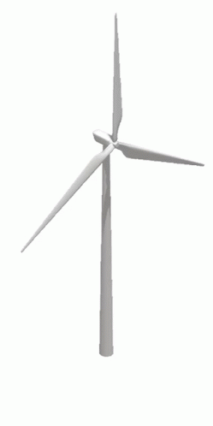

Problem Statement/Use case
To predict and raise alerts for outages, maintenance required, Inspections required from the sensor data using GGSA.
Notes:
Our sol helps us in – based on the deviations in the data. – condition monitoring system
Some benefits include:
Reducing machine failures, which saves lot of money
Extend asset life
Increase the rate of production
Cut maintenance costs
Prioritising Maintenance Tasks
With frequent and reliable updates about your machinery, you have a real-time list of potential maintenance tasks and their priority.

Slide 3
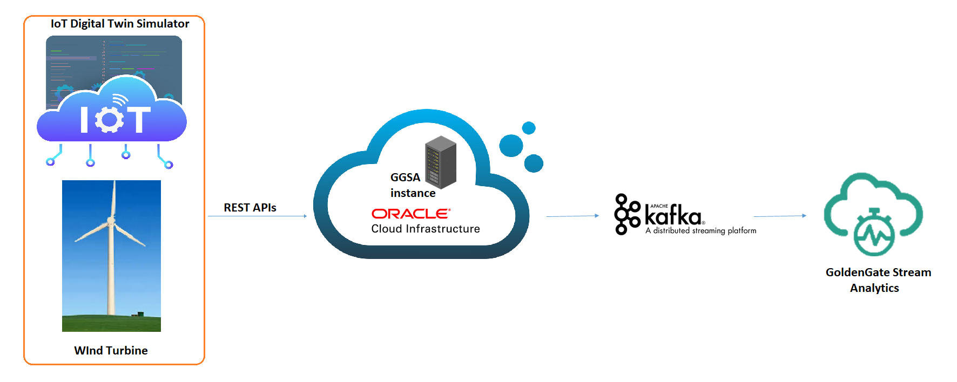


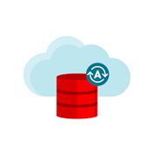
Design
OIC
WAM
Oracle autonomous database
Notes:
This is the over all design of the solution,
All attributes wind turbine sensor – fetch – api into GGSA,
GGSA – mathematical operations are performed, based on patterns or deviations it can generate some alerts
Final Filtered data gets populated
now lets get into the low level details

Slide 4
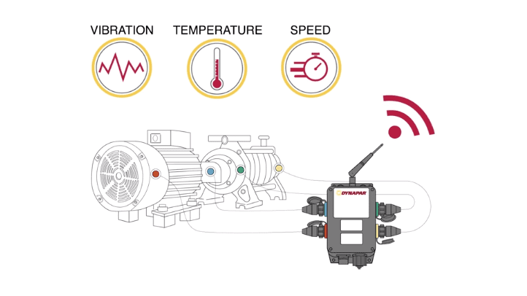
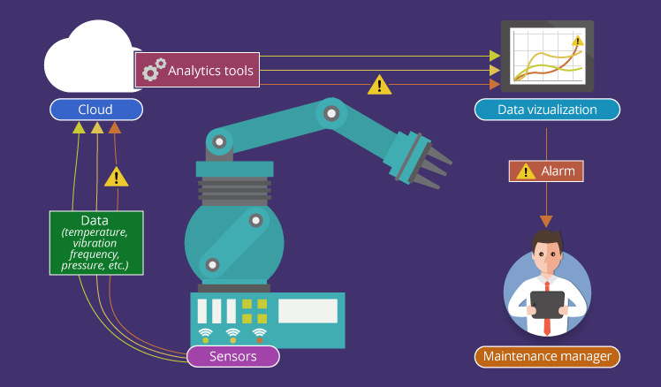
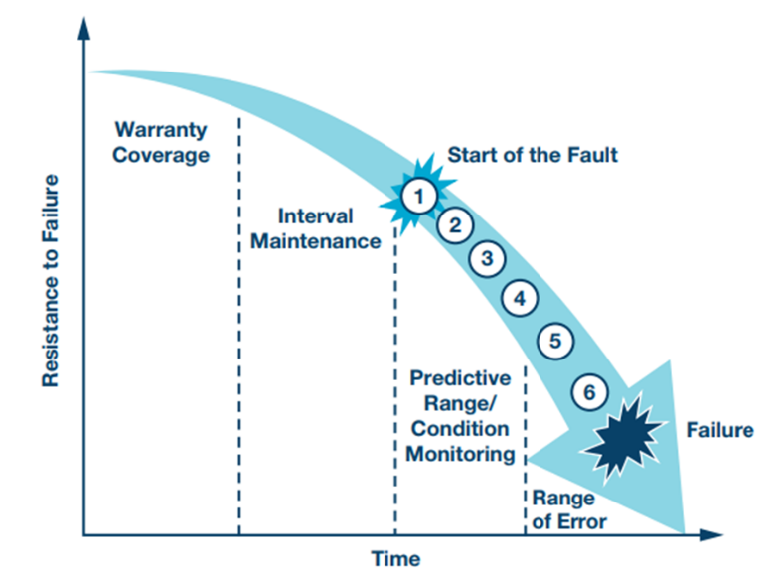
Condition Monitoring Benefits
Lowering Maintenance Costs
Maximizing Production Output
Extend asset Life
Reducing machine failures
Prioritizing Maintenance Tasks
Notes:
It revolves around the principle of predictive maintenance, which is a proactive way of fixing malfunctioning equipment before they cause problems

Slide 5

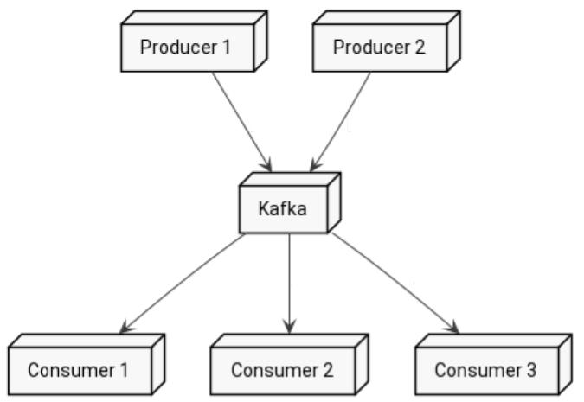
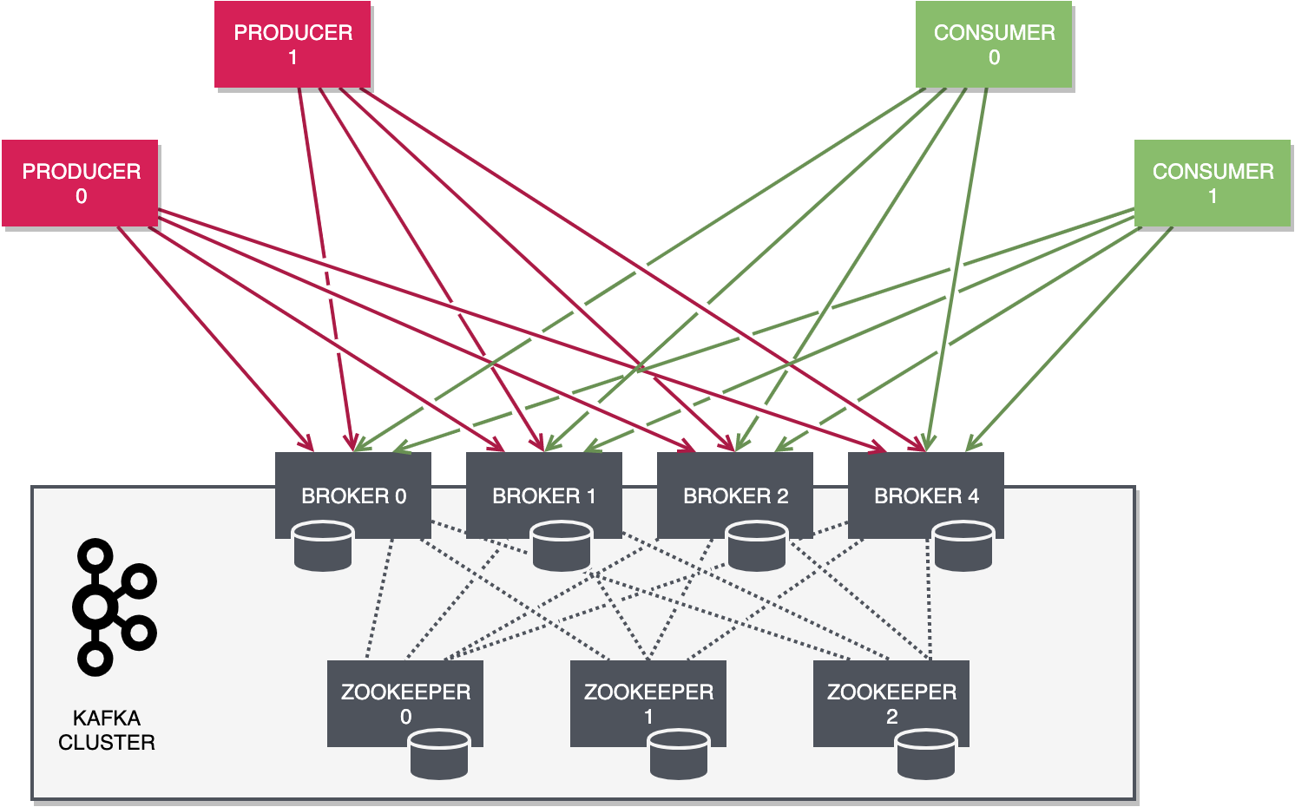
Tools Used:
GGSA
Kafka (comes by default in GGSA instance)
REST APIs
python3
Pip3
Python Modules
requests
pytz
json
screen
Dependencies
Notes:
publish-subscribe based distributed queuing system
A Topic is a category/feed name to which records are stored and published.
features
Kafka topics are multi-subscriber.
Records published to the cluster stay in the cluster until a configurable retention period has passed by.
The performance of Kafka is not affected by the data size of messages, so retaining lots of data is not a problem.
Log retention period – size based, time based, 3 days as of now
Kafka retains records in the log, making the consumers responsible for tracking the position in the log, known as the “offset”. Typically, a consumer advances the offset in a linear manner as messages are read.
consumer can reset to an older offset when reprocessing records.

Slide 6
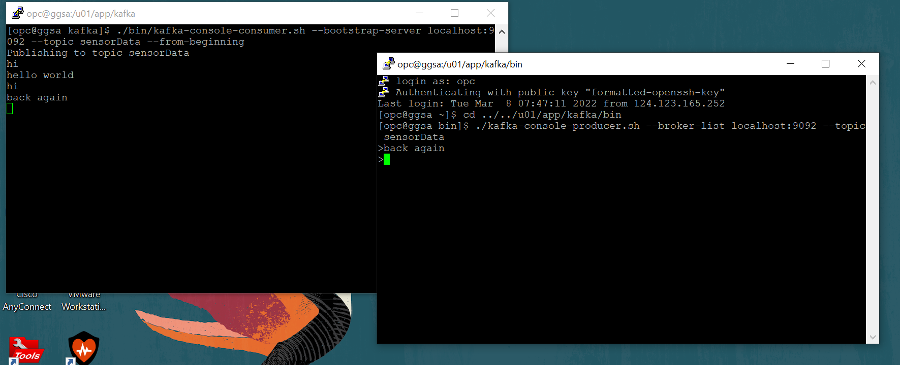
Step 0: Created a topic in Kafka to stream the data and tested
Notes:
Kafka comes by default in GGSA
Tested kafka by topic sensorData, 2 sessions to GGSA

Slide 7
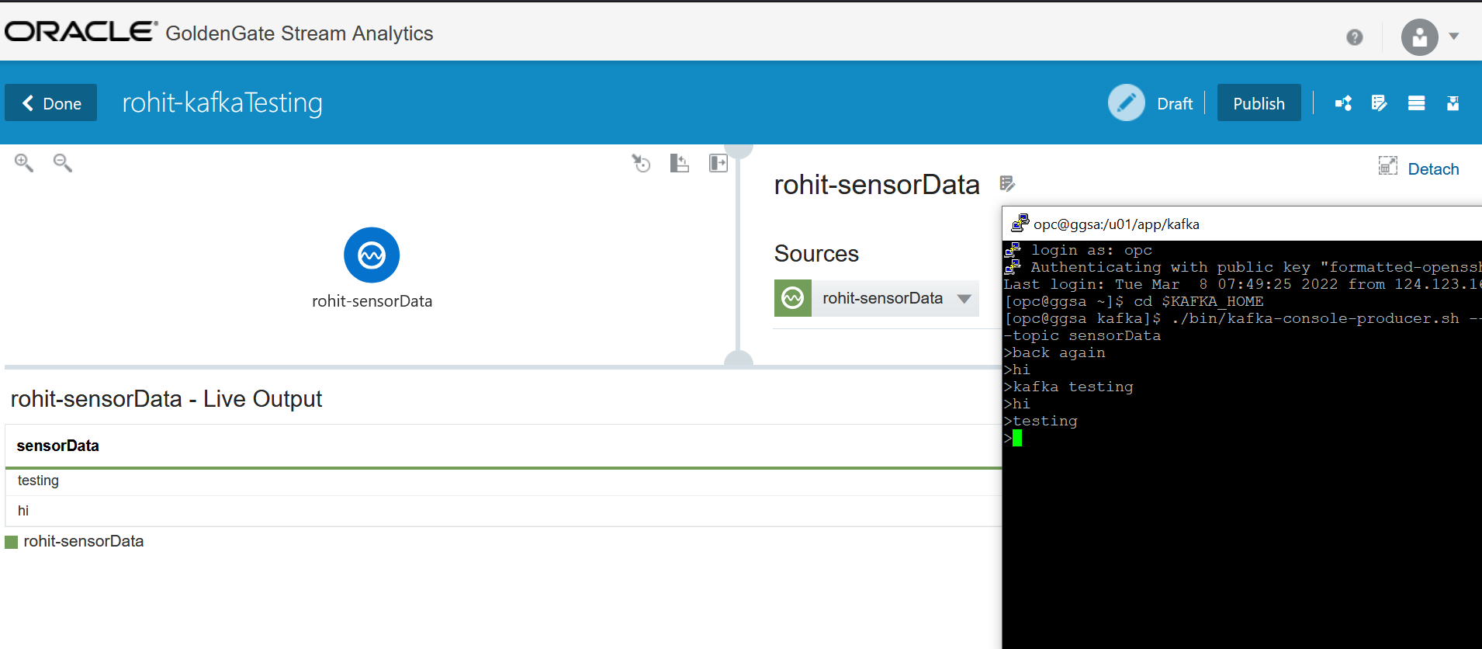
Step 1: Consuming the data published to topic from GGSA

Slide 8
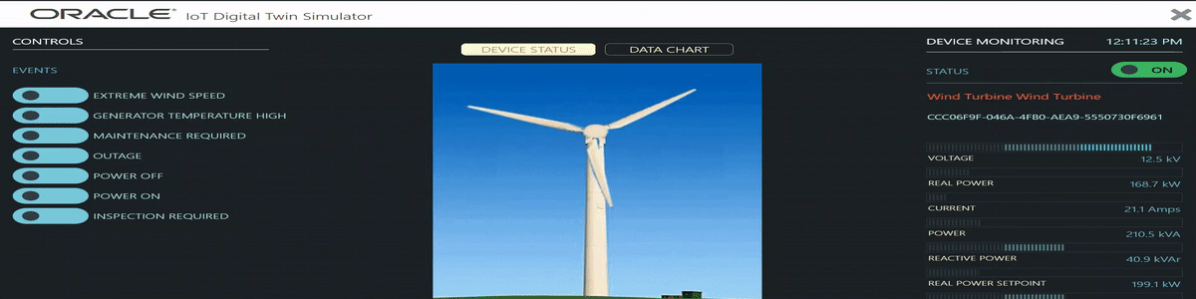
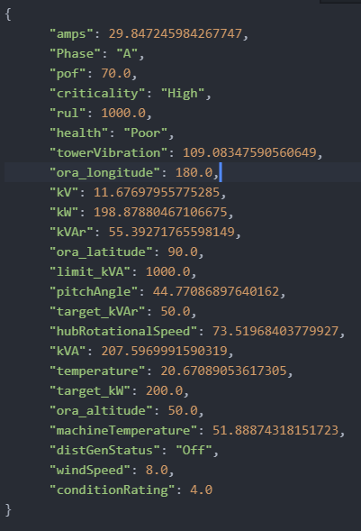
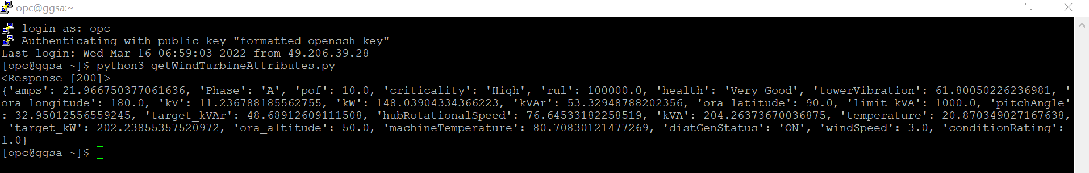
Step 2: Fetching attributes of wind Turbine to GGSA instance.
data.json
Output saved to a file
REST APIs

Slide 9

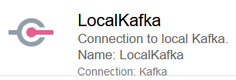
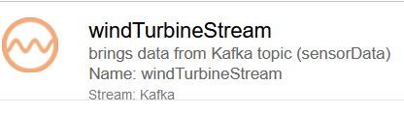
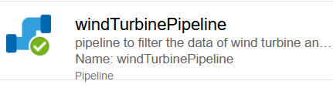
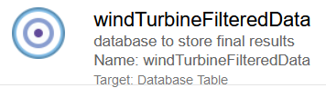
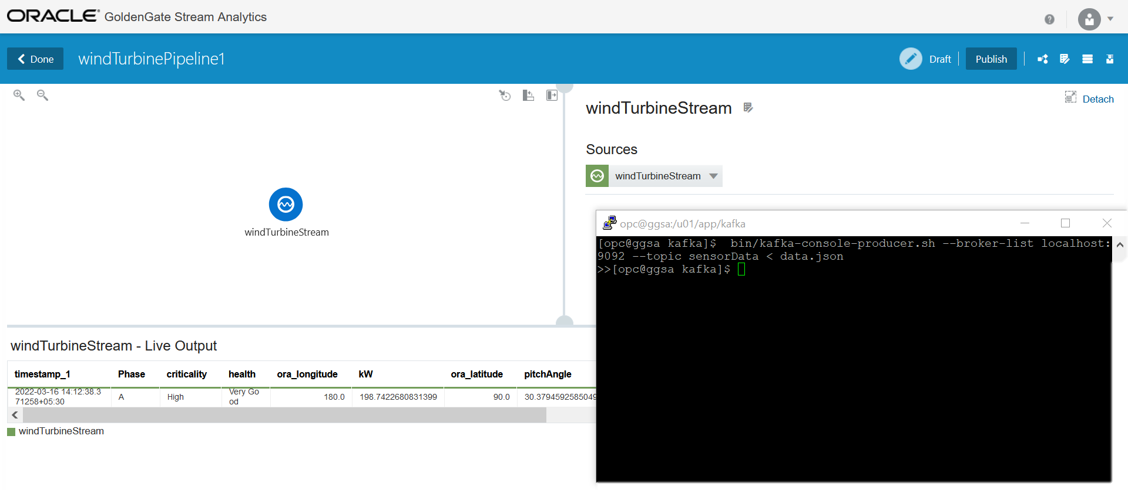
Step 3: Publishing the fetched sensor data to Kafka topic and consuming it from GGSA
Notes:
Autonomous db populate automatically – filtered data

Slide 10
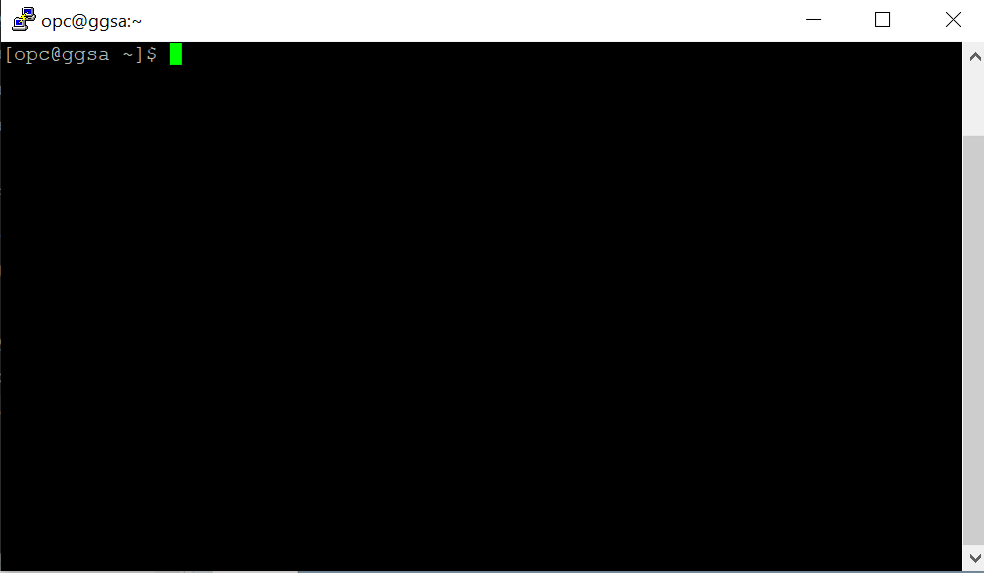
Step 4: Looping step 2,3 using bash script for every 1 min as a child process and detaching it from the terminal
while true
do
python3 getWindTurbineAttributes.py
bin/kafka-console-producer.sh --broker-list localhost:9092 --topic sensorData < data.json
sleep 60
done

Slide 11
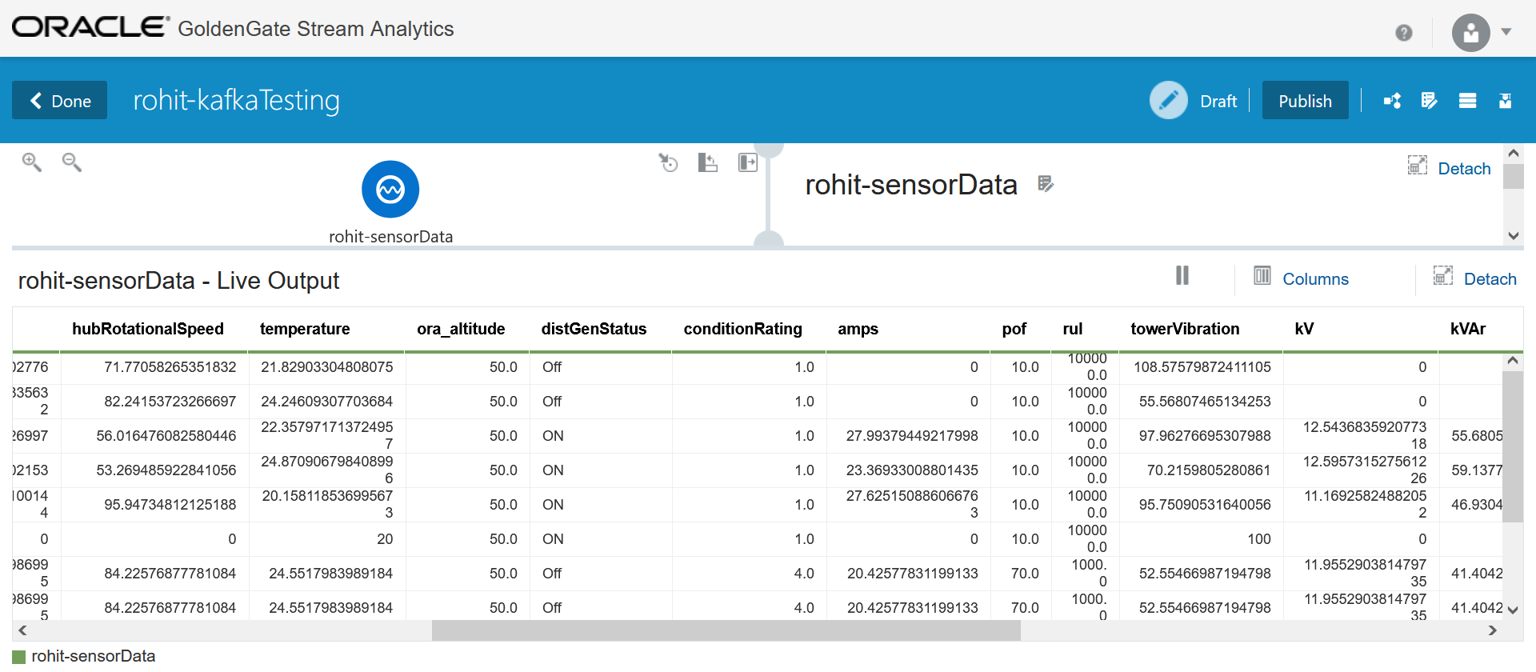

Slide 12
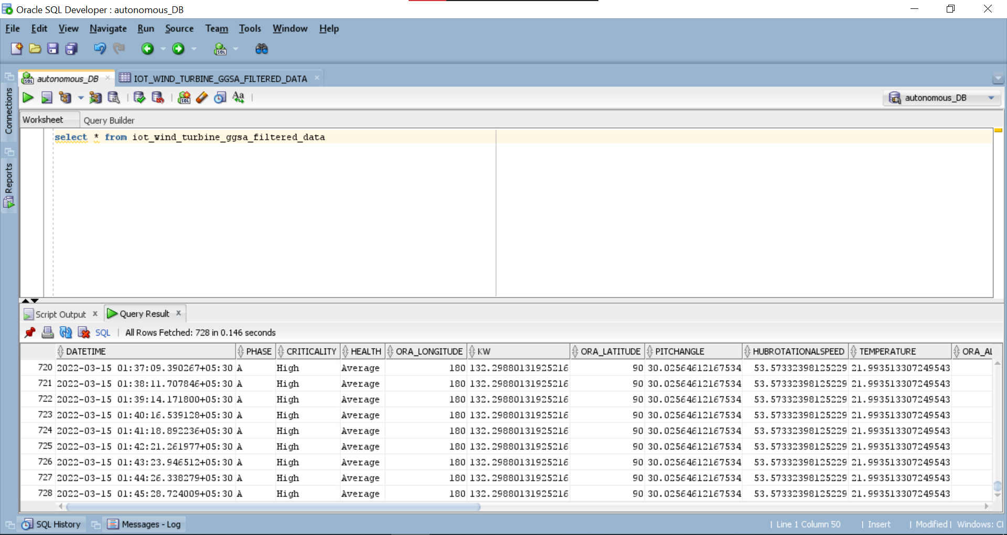

Slide 13
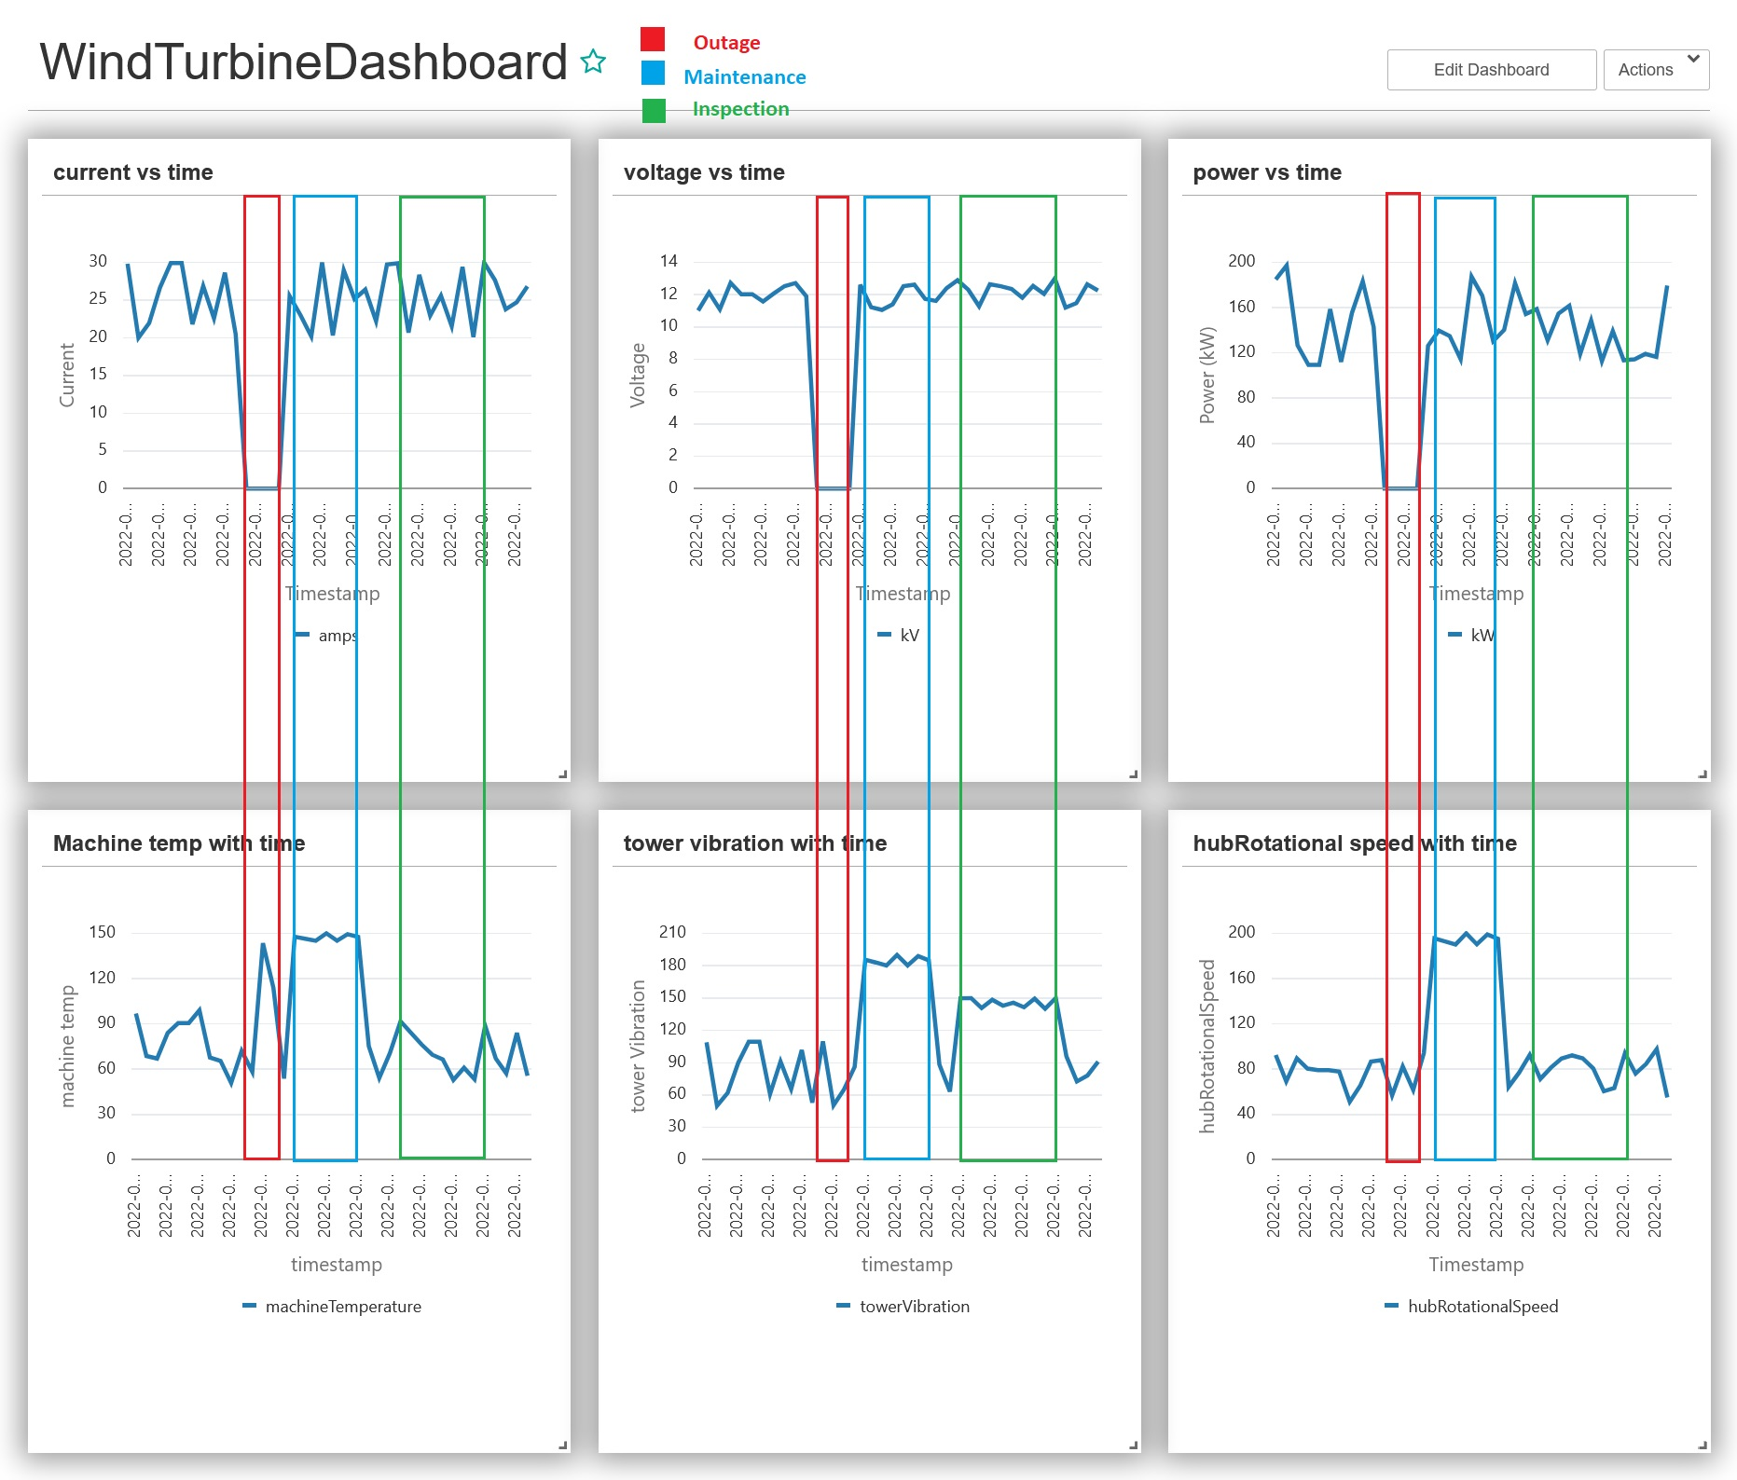
Step 5: Identifying the patterns in the data for the events

Slide 14
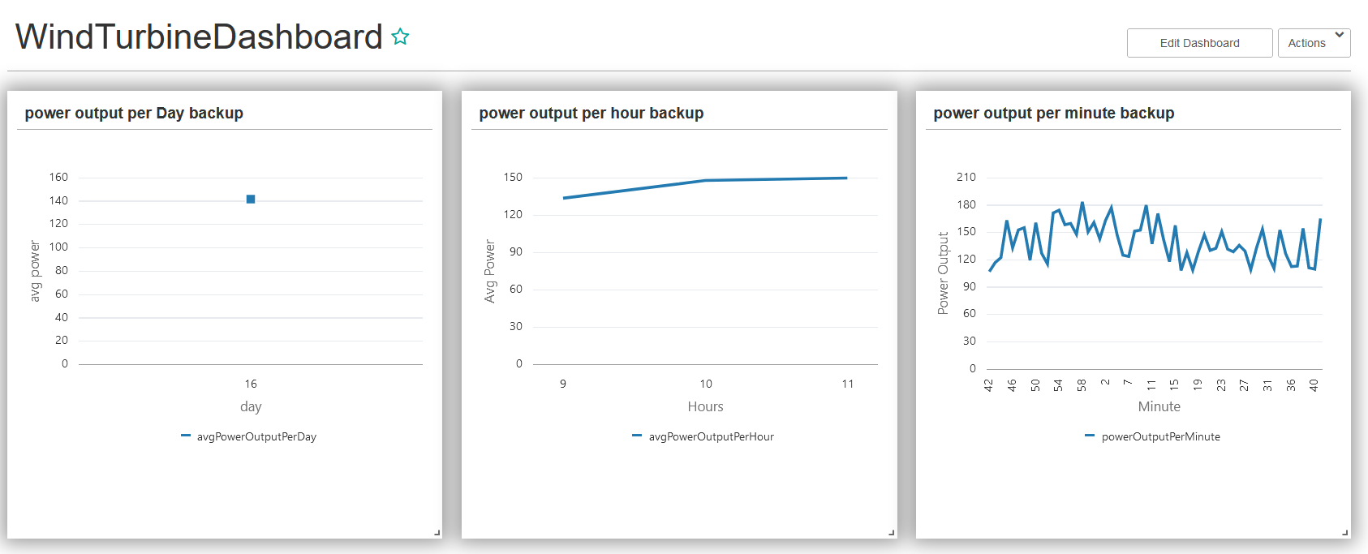
Step 6: Visualizing the data

Slide 15
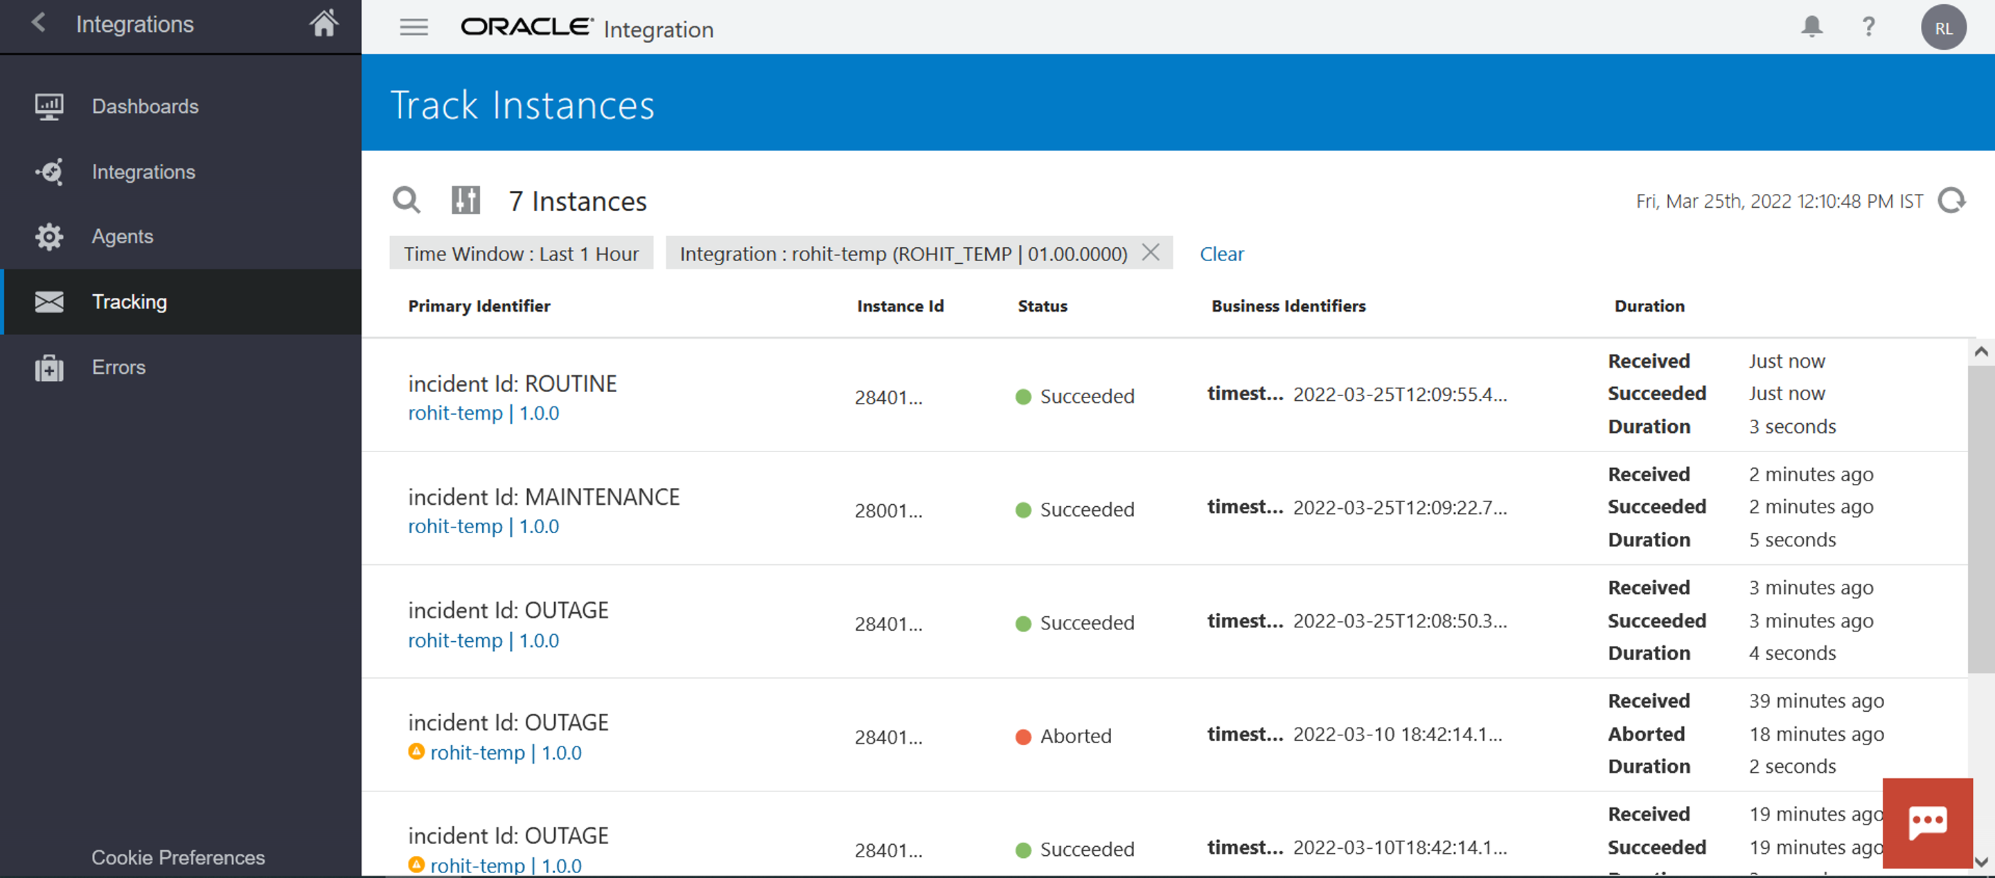
Step 7: Predicting the Events and triggering an Integration

Slide 16
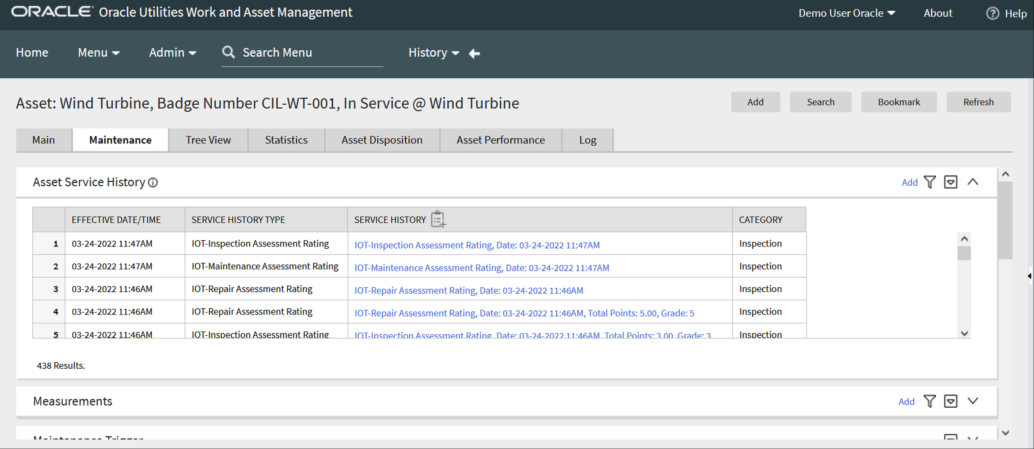
Step 7: Creating WAM Activity in IOT Work Order

Slide 17
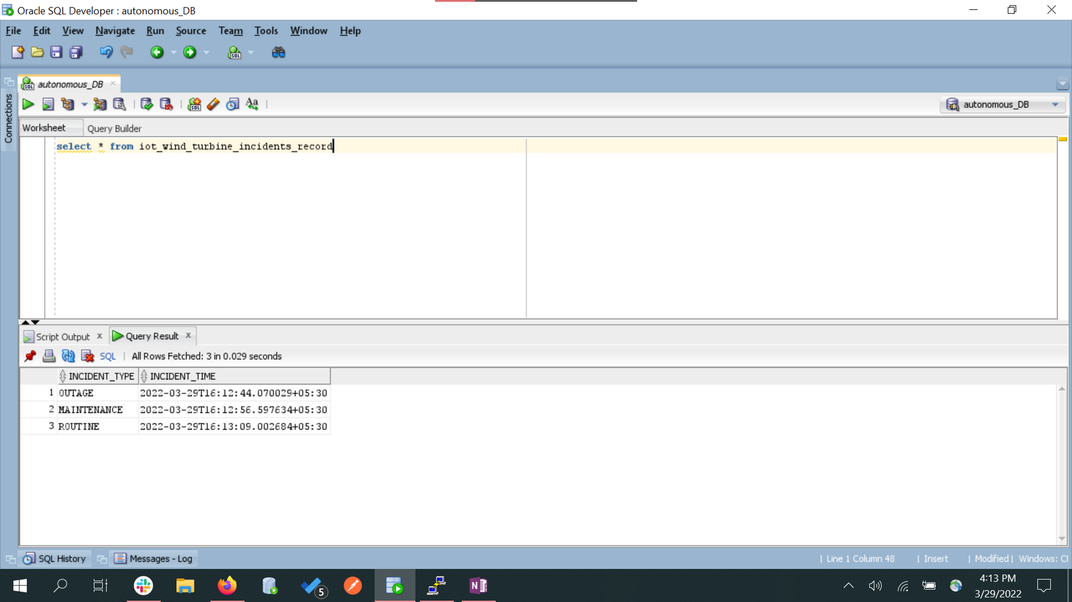
Step 8: Keeping track of all the occurrence of events in database

Slide 18
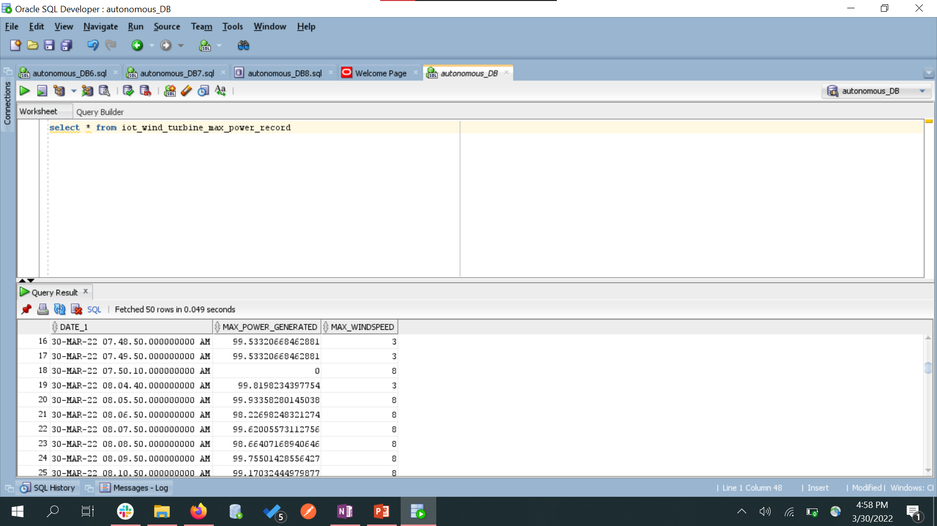
Step 9: Keeping track of max power output and max wind speed per day in the database

Slide 19
Demo

Slide 20


Slide 22
Connecting to Autonomous Database
Create an Autonomous Database in OCI
Download the wallet
Import the wallet in GGSA/SQL Developer as shown in further slides.

Slide 23
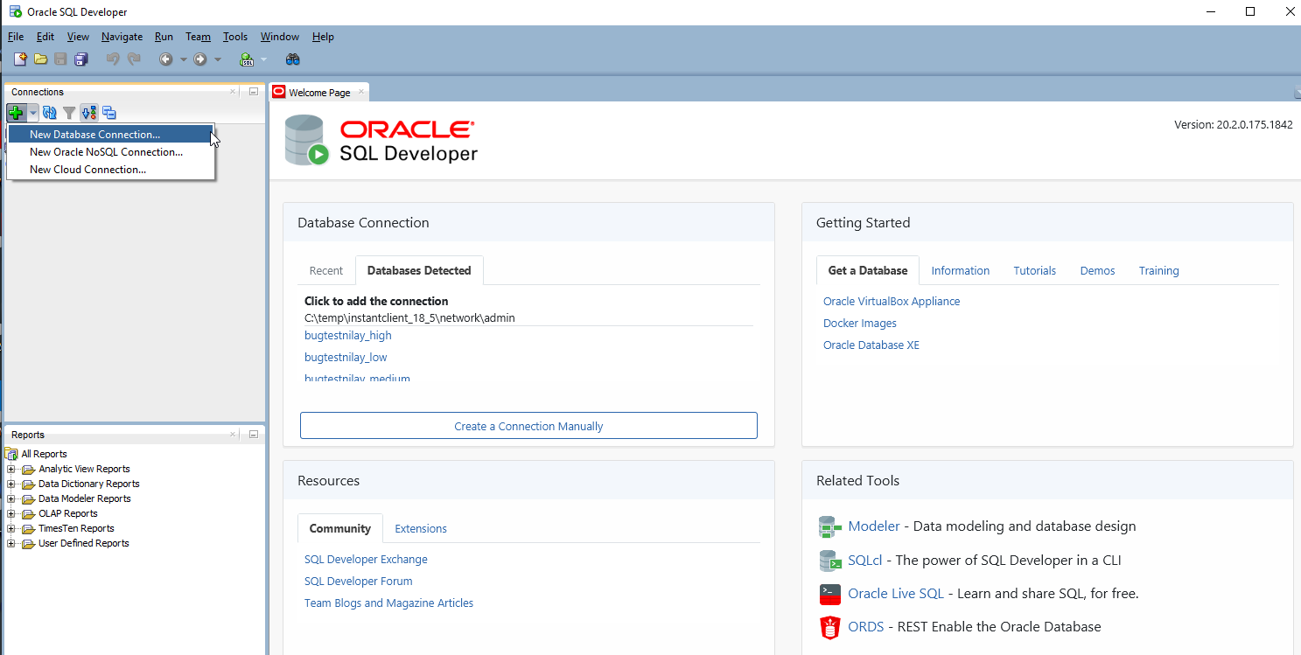
Start Oracle SQL Developer and in the connections panel, right-click Connections and select New Database Connection....

Slide 24
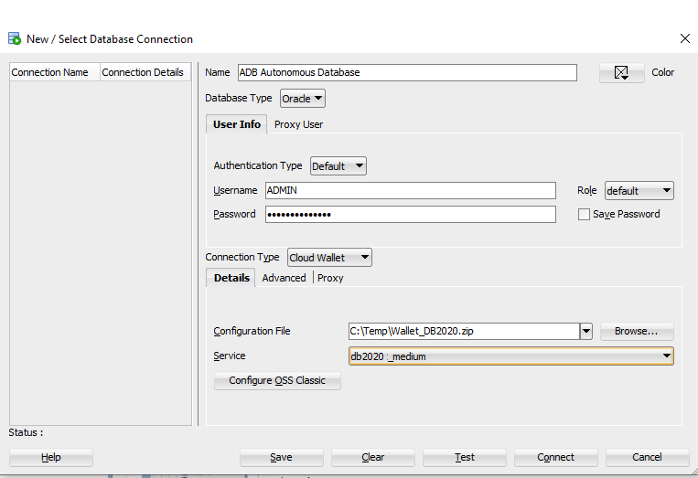
Choose the connection type cloud wallet
Username: Enter database username or ADMIN default uname
Enter db user password
Browse for ceredentials.zip file can be downloaded from OIC

Slide 25
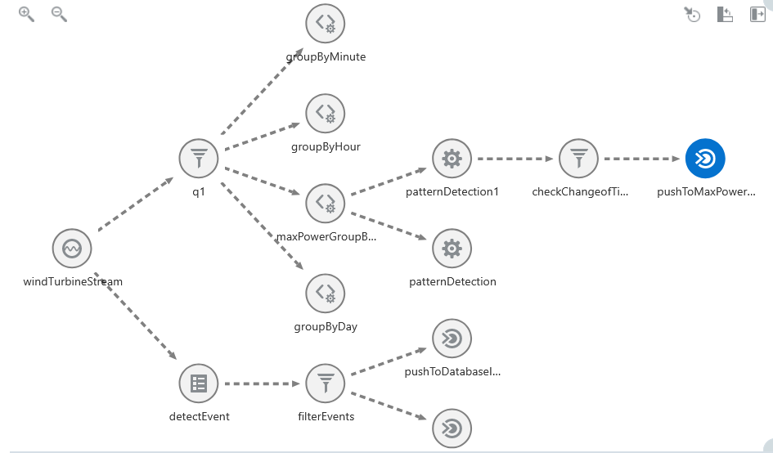
GGSA Pipeline

Slide 26
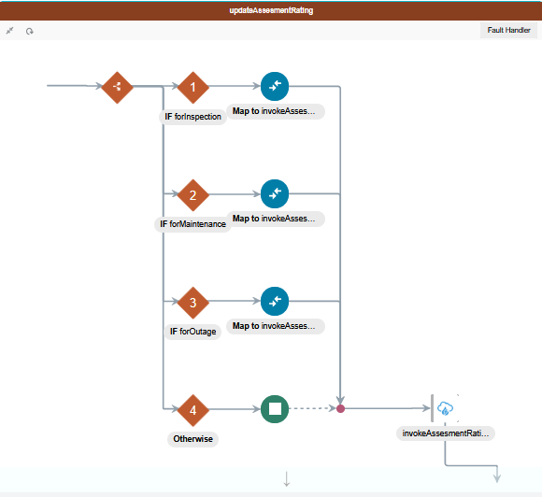
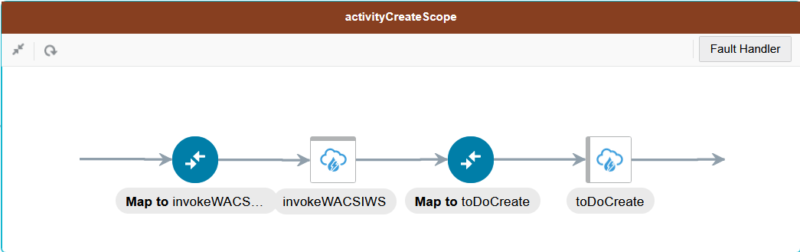
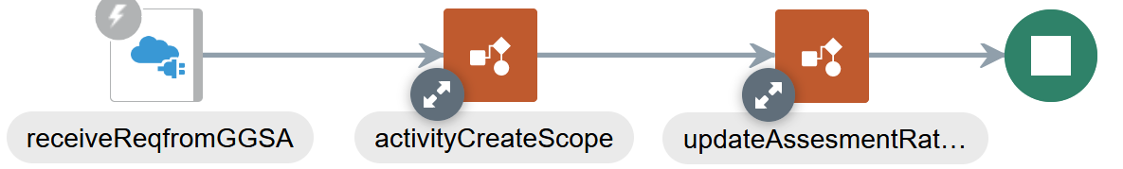
OIC Integration

